Slide 1
WEB CRAWLER USING JAVA
Guide – Prof. Aarti M.Karandikar
Group Members :
Abhishek R.Parmar (B-34)
Anurag R.Tiwari (B-44)
Pritam R.Sah (B-67)
Sambhav S.Chopda (B-68)
Saurabh R.Nampalliwar (B-70)

Slide 2
Introduction
Crawl means fetch
Also known as web spiders and web robots.
Less used names- ants,bots and worms.

Slide 3
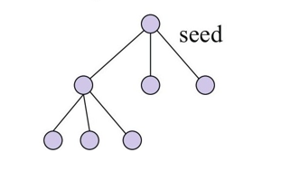
Web Crawler
The process or program used by search engines to download pages from the web for later processing by a search engine that will index the downloaded pages to provide fast searches.

Slide 4
How does web crawler work?
It starts with a list of URLs to visit, called the seeds.
As the crawler visits these URLs, it identifies all the
hyperlinks in the page and adds them to the list of
visited URLs, called the crawl frontier.

Slide 5
Crawl policies
Selection policy
Politeness policy

Slide 6
Selection policy
A selection policy that states which pages to download.
Based on :
Pageranks
Path ascending
Focused crawling

Slide 7
Politeness Policy
Costs of using web crawlers include:
Network resources, crawlers require bandwidth and operate with a high degree of parallelism during a long period of time;
Server overload, if the frequency of accesses to a given server is too high;
Poorly-written crawlers, can crash servers or routers, download pages they cannot handle; and
Personal crawlers, if deployed by too many users, can disrupt networks and web servers.

Slide 8
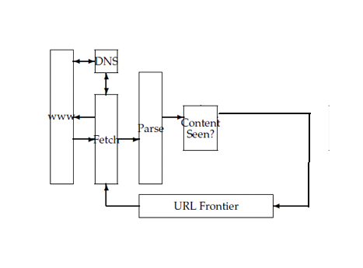
Architecture of Web Crawler
Fig. Architecture of Web Crawler

Slide 9
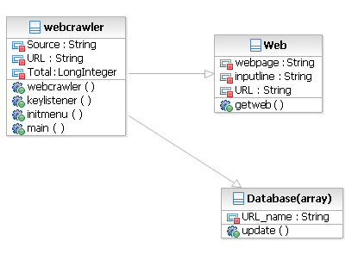
Data Structure (Components) :
Fig. Data Structure

Slide 10
URL Extraction
To extract hyperlink URLs from a Web page, we can use these parsers to find anchor tags and grab the values of associated href attributes.
Convert any relative URLs to absolute URLs using the base URL of the page.
Different URLs that correspond to the same Web page can be mapped onto a single canonical form.

Slide 11
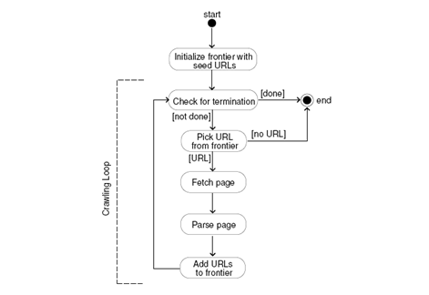
Fig. Working of Web Crawler

Slide 12
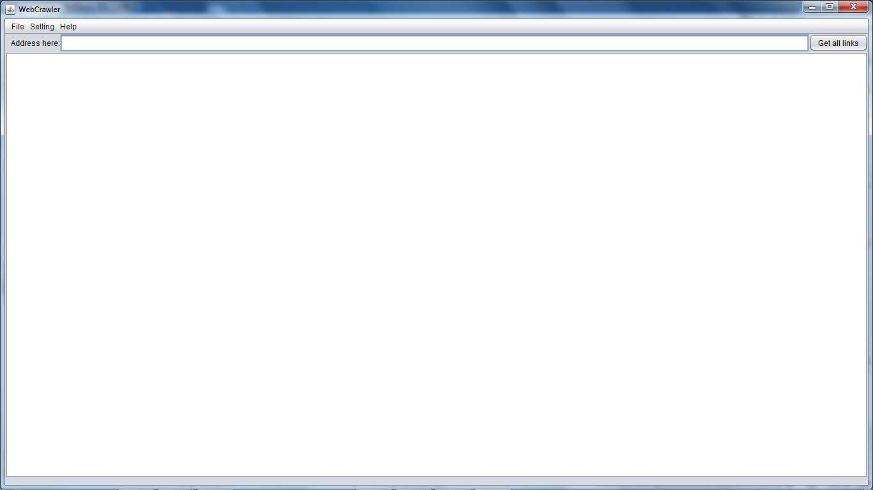
Screen-shots
Front Screen :

Slide 13
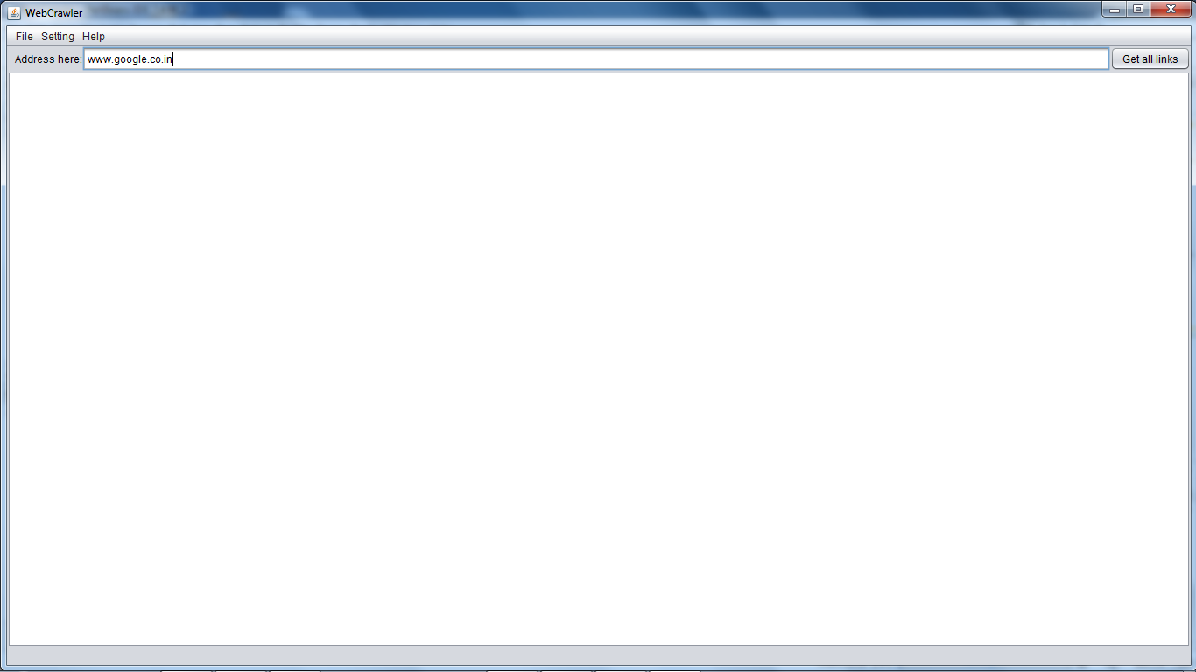
Screen with Entered Address :

Slide 14
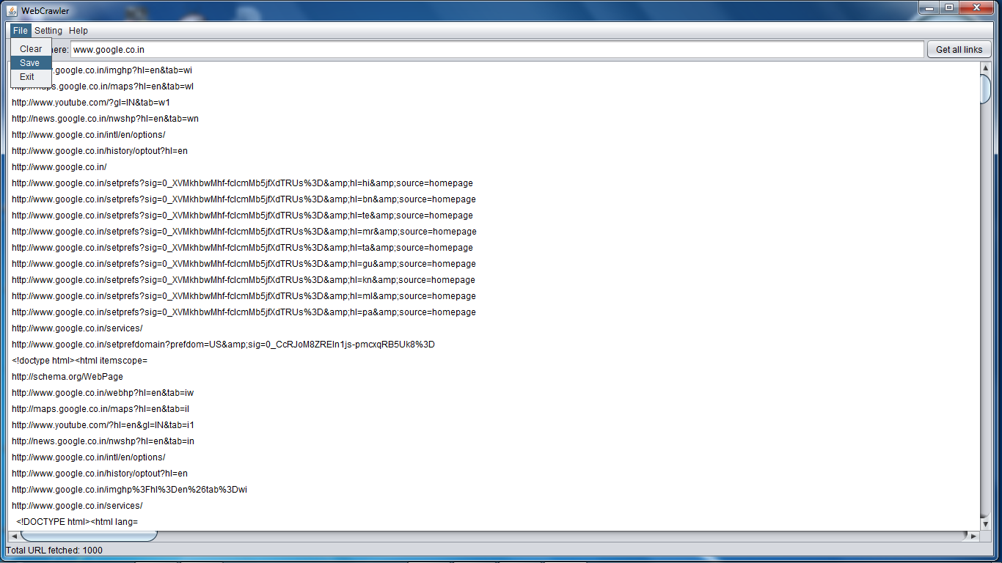
Screen with Fetched Links :

Slide 15
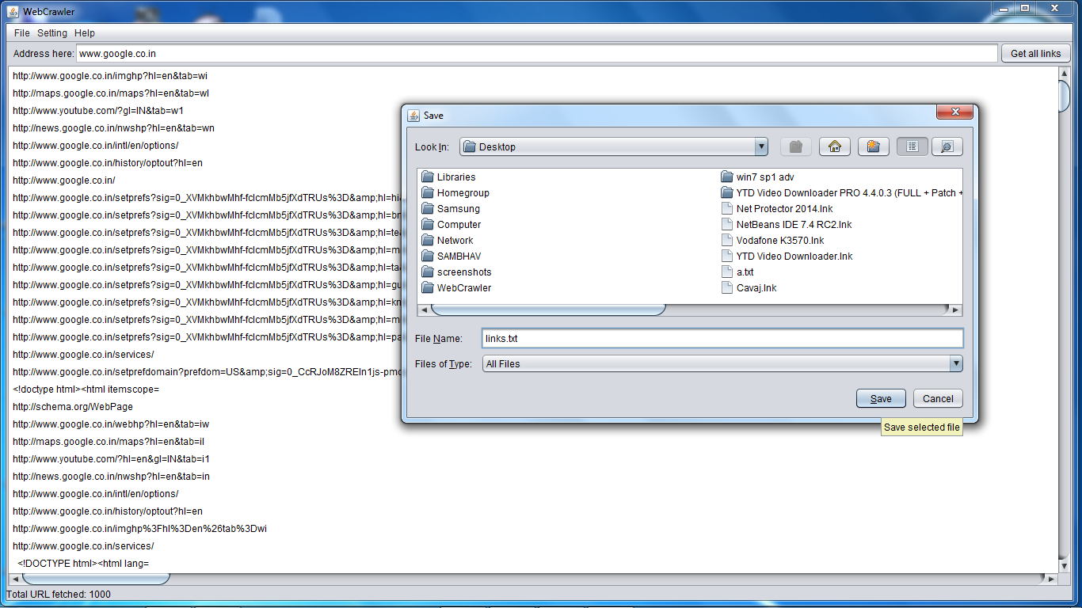
Screen with ‘Save’ Dialog Box :

Slide 16
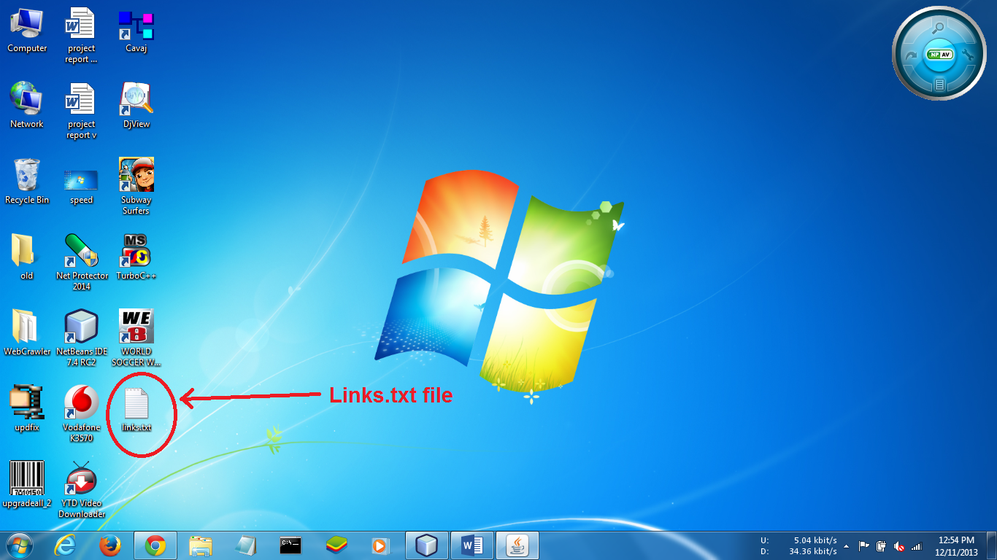
Destination of saved file:

Slide 17
Test-Cases
Case 1: No Internet Connection
If user type correct input in address bar, but if the internet connection is not available in that system then message will display telling that address is invalid.
Case 2: Invalid URL
If the user type invalid URL into the address box then it will display message telling that the URL entered is not a valid URL. So user need to write URL again into the address bar.

Slide 18
Test-Cases (Contd.)
Case 3: URL not exist
If the user type URL and if it does not exist or may be that particular site has been deactivated then it will display message that URL is not valid or does not exist.
Case 4: Security concern
Suppose the user type the URL but firstly user need to log in to access the particular site then it will prompt that please log-in.
E.g. In our college we need to login Cyberoam to use Internet Connection.

Slide 19
Uses Of Web Crawler
Find stuff
Gather stuff
Check stuff

Slide 20
Examples
Yahoo! Slurp: Yahoo Search crawler.
Msnbot: Microsoft's Bing web crawler.
Googlebot : Google’s web crawler.
WebCrawler : Used to build the first publicly-available full-text index of a subset of the Web.
World Wide Web Worm : Used to build a simple index of document titles and URLs.
Web Fountain: Distributed, modular crawler written in C++.
Slug: Semantic web crawler

Slide 21
CONCLUSION
Web crawlers are an important aspect of the search engines.
Web crawling processes deemed high performance are the basic components of various Web services.

Slide 22
Future Scope
The project extracts, collects the data from various websites successfully, this work could be extended in near future.
This project could be integrated with the database as back end to be used as a database for the search engine.
The information collected by web crawler could be used to track the interested areas of the user through mostly visited pages.

Slide 23
References
Websites :
https://en.wikipedia.org/wiki/Web_crawler
http://s3.amazonaws.com
Books :
Data mining.

Slide 24
THANK YOU

